Slide 1
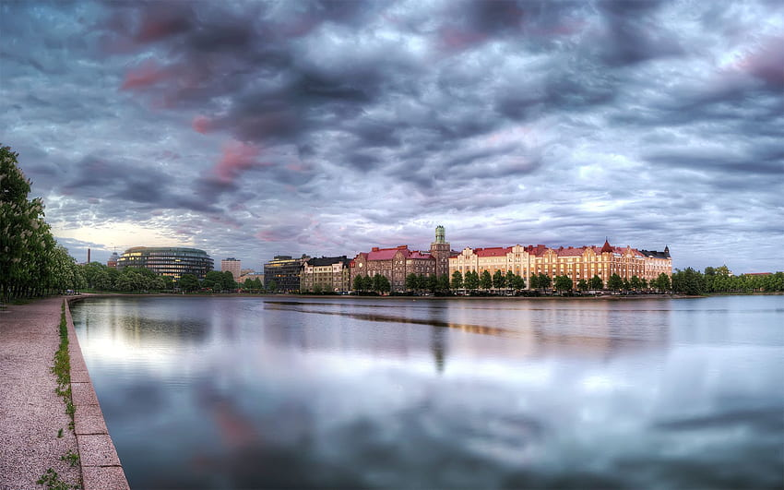
FINLAND
Underground City
by Charbel Sassine
Johnny Haro
Antonio Hanna
Elie Menhem
Charbel Boutros

Slide 2
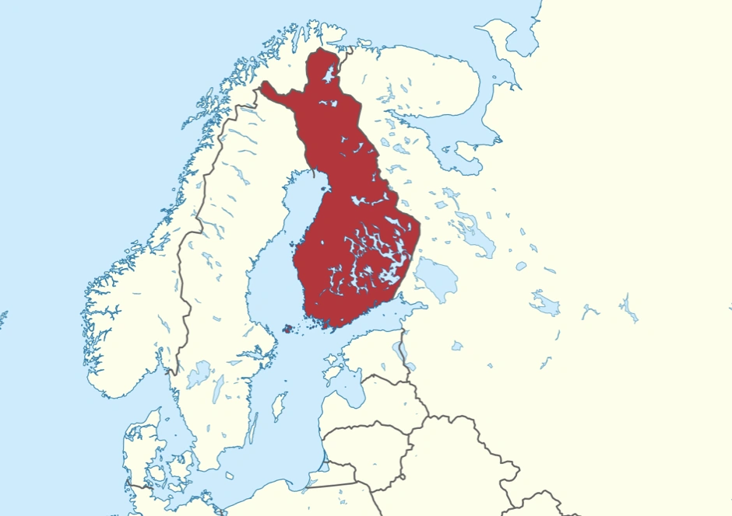

Finland may be world's happiest country -- at least on the surface. But Helsinki's "underground city" tells a different story.

Slide 3
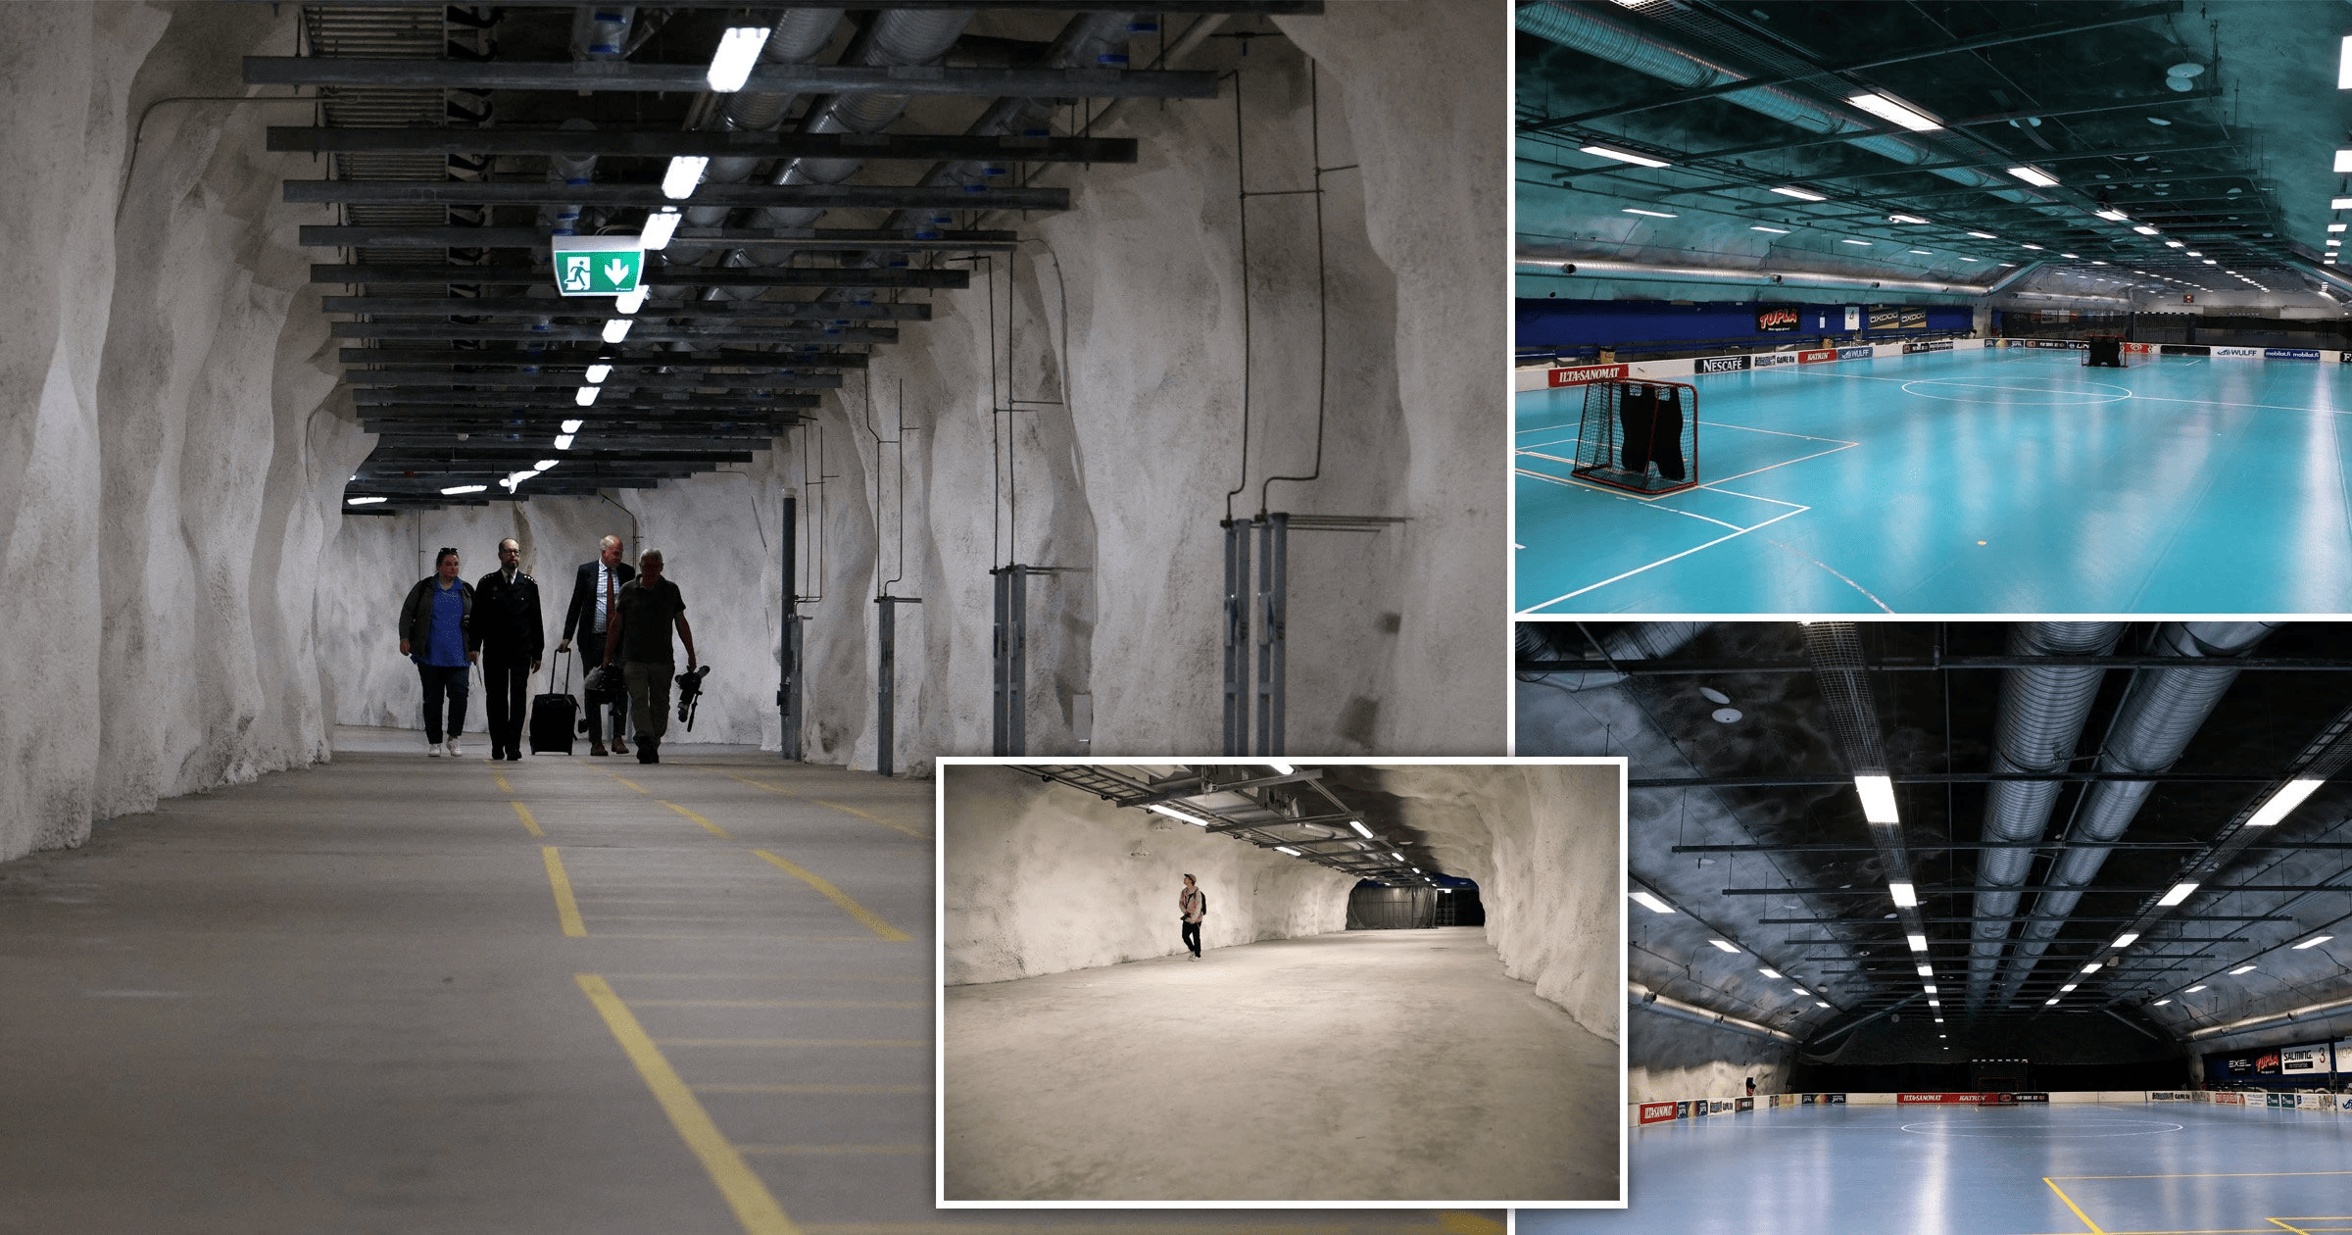
Beneath the capital, a massive network of bunkers and tunnels spreads out all across the city. There are than 5,000 bomb shelters in Helsinki -- enough to shelter more than the city's entire population -- and more than 50,000 bunkers across the country, according to Helsinki's Civil Defense Department. All buildings above a certain size are required by law to have their own bunkers.

Slide 4
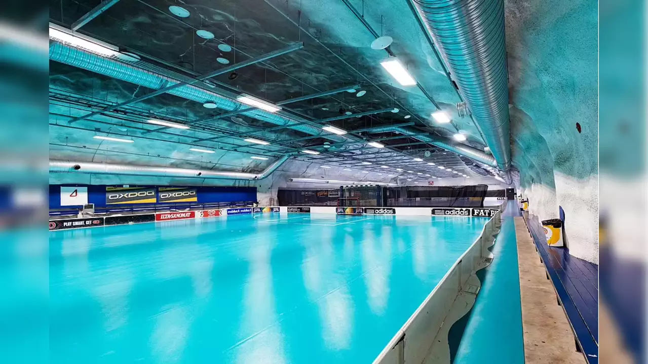
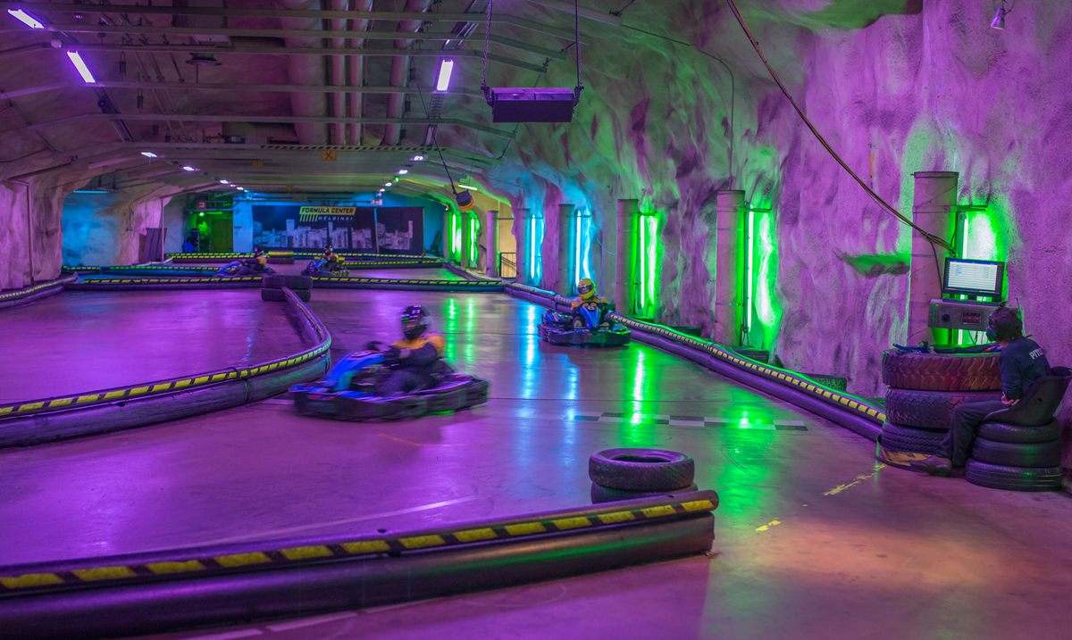
With so much ground going unutilized, the city of Helsinki has converted some of its shelters into spaces for everyday public use. There's an underground playground, a shelter that doubles as a hockey rink, even an underground swimming pool

Slide 5
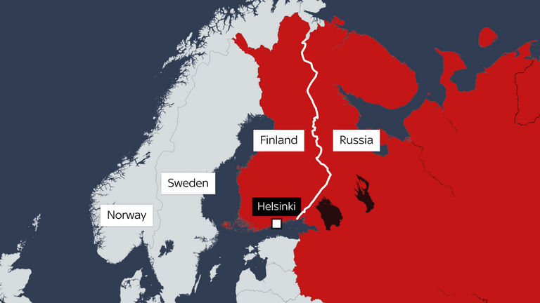
This is what it's like being Russia's neighbor. The two countries share an 800-mile border and a long, complicated history.

Slide 6
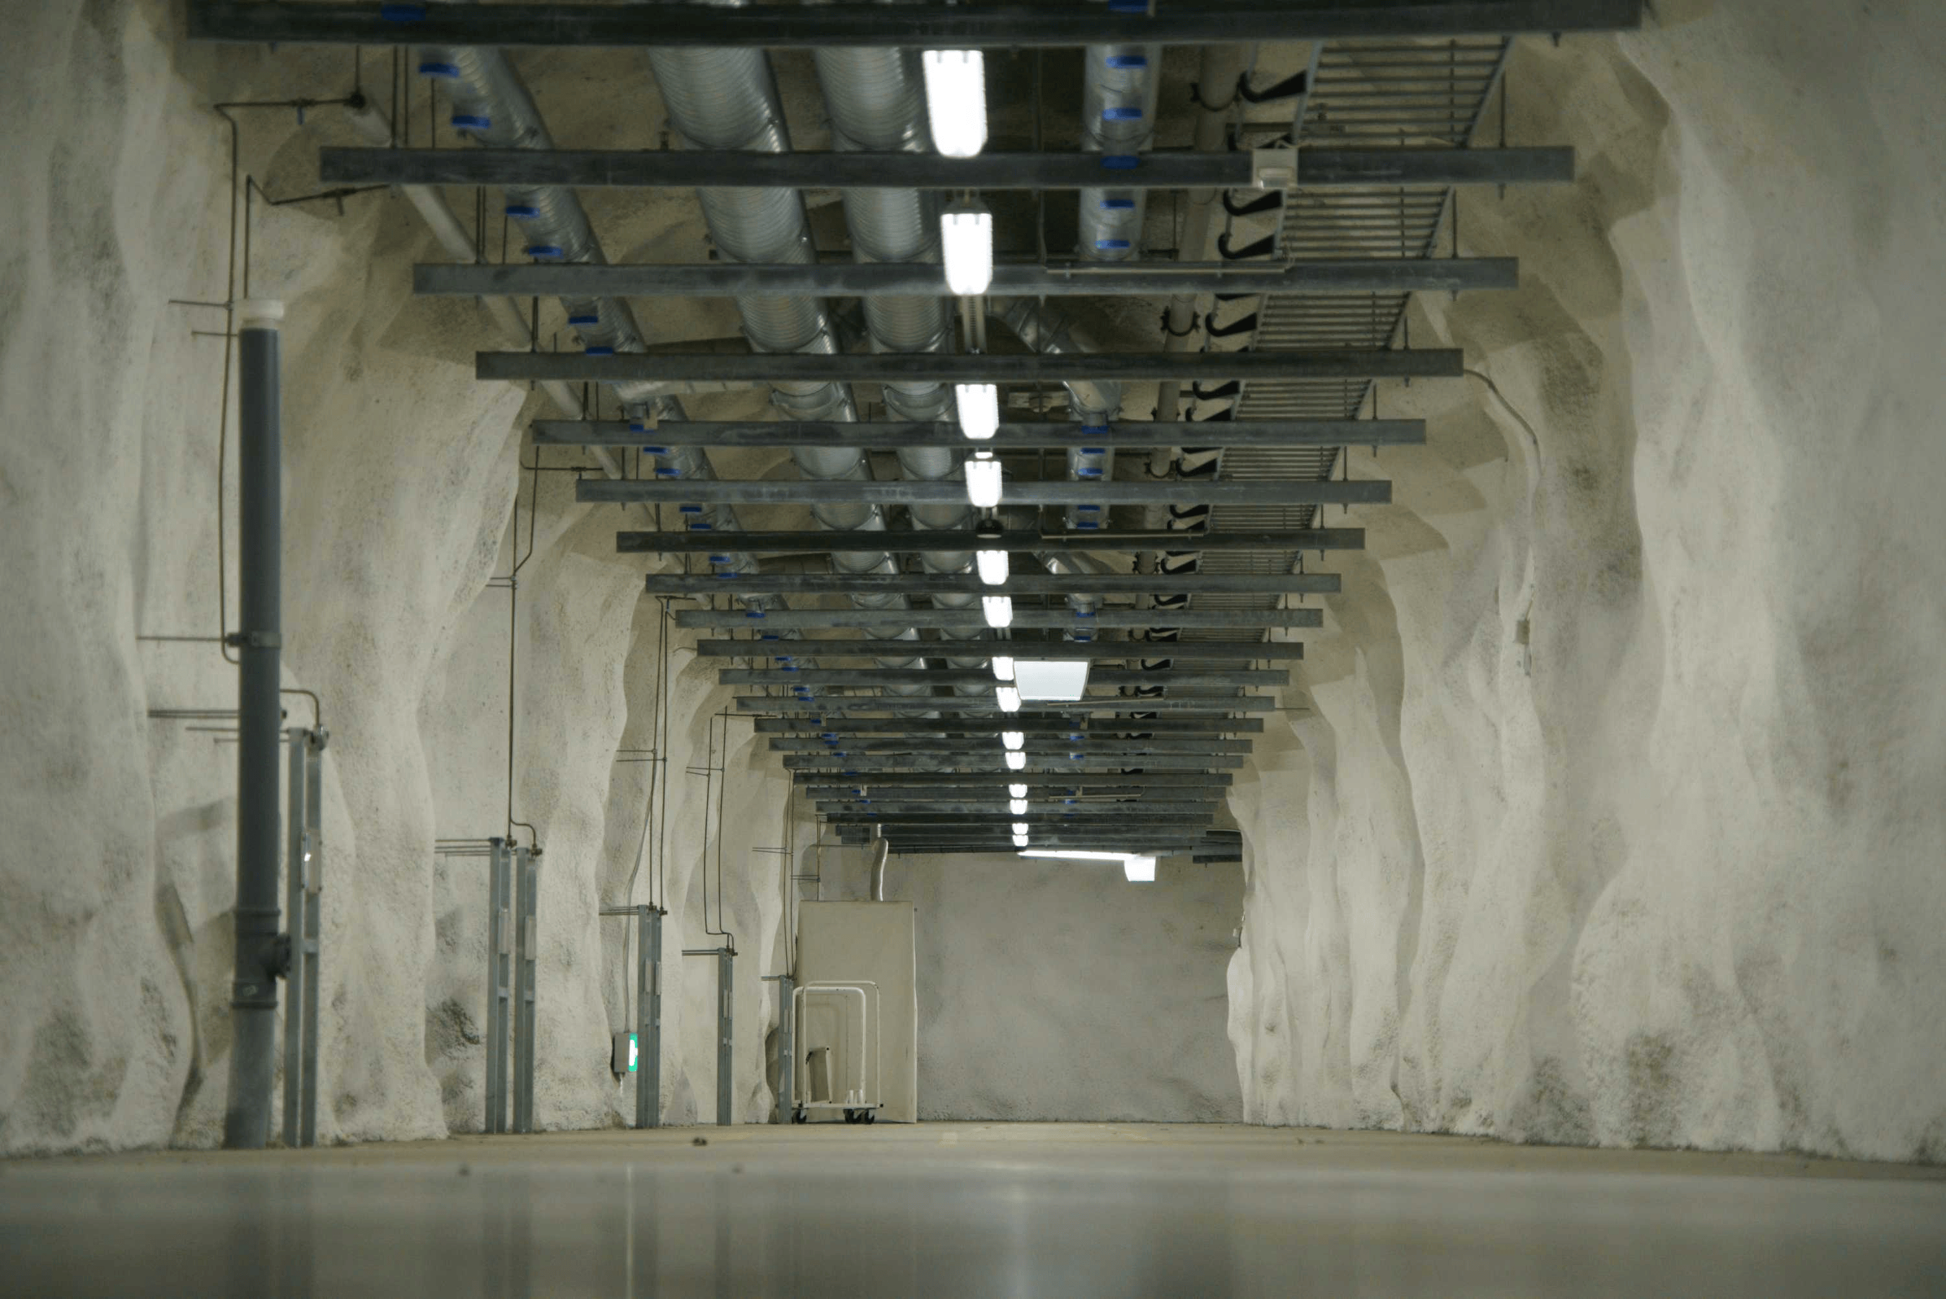
For decades, Finland opted not to join any military alliance in an effort meant to appease Russia's security concerns. As a result, Finland had to ensure it could fend for itself. So it's not just the bunkers; conscription is still mandatory for men, and the country has about 900,000 reservists.

Slide 7
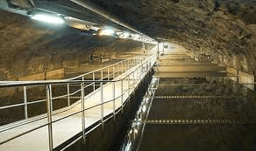
The underground bunker was designed with the purpose of averting a nuclear disaster, providing a safe space for the people of the country in case such an instance occurs.
The bunker is reportedly 30 meters deep, and is around nine million square meters.

Slide 8
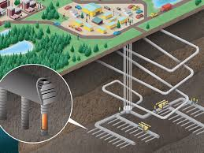

Slide 9

“I have always felt that we are safe in Scandinavia. There is no dreadful war here. Of course, Finland has lived beside Russia. They [Russia] can do things how they like, and the war in Ukraine is proof for that,” said Artio Heinonen, a Helsinki resident.

Slide 10
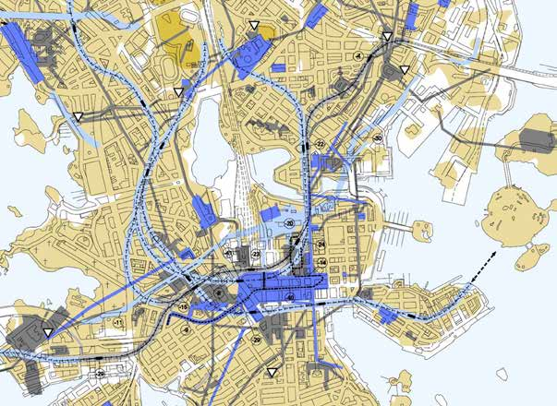

Slide 11
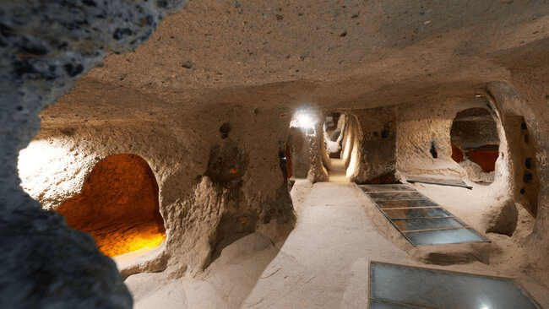
There are mane tunels in this place. The structure of the building and its depth is comparable to 30 meters.

Slide 12


